Slide 1
Guide for IVE request submission BEP RNA-IVE team

Slide 2
IVE can be requested in 2 ways (the eTLs should submit the request)
Genedata Biologics by entering PPB-number, clicking on ‘Request IVE’ in the gear icon drop down
In GDBxT page, HTEP mRNA, BEP mRNA, or FRS production by clicking on a request, scrolling to the bottom to select PPBs and clicking on the ‘Request IVE’ button
In GDBxT page, clicking “IVE analysis request sets → BEP IVE homepage
Notification via email
Your request can be confirmed by
Genedata Biologics (pfizer.com)
Protein Production Home Page (pfizer.com)
Formulation Request Set List (pfizer.com)
View IVE Requests (pfizer.com)

Slide 3
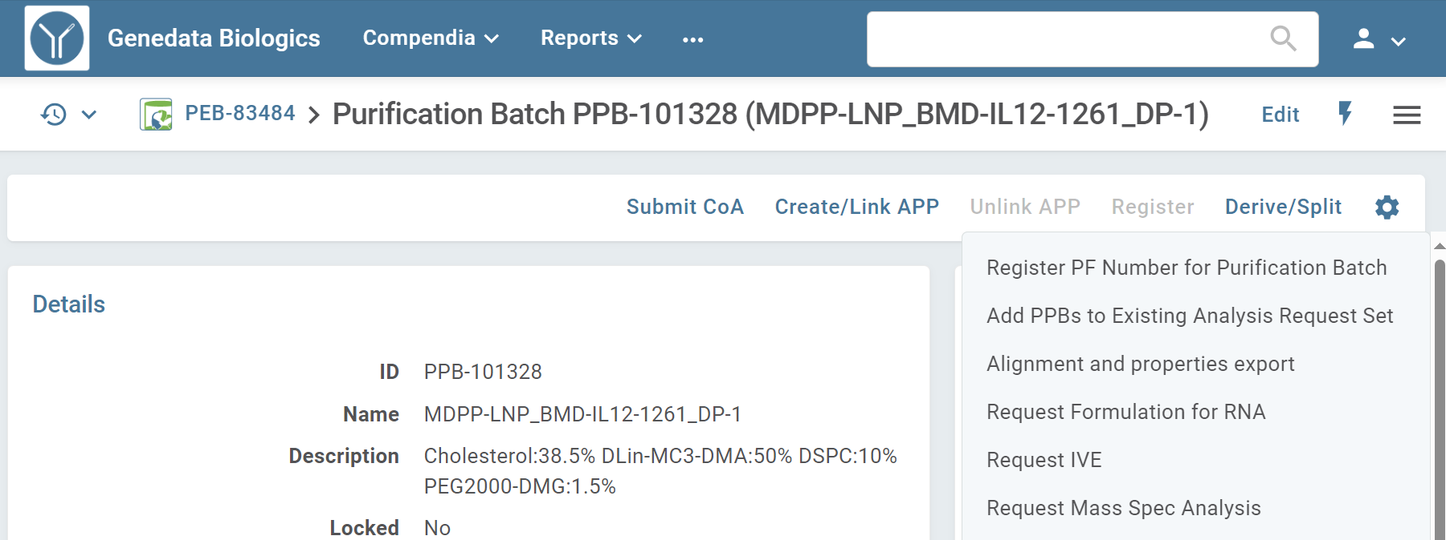
By entering PPB number in Genedata
Enter your samples PPB number in search

Slide 4
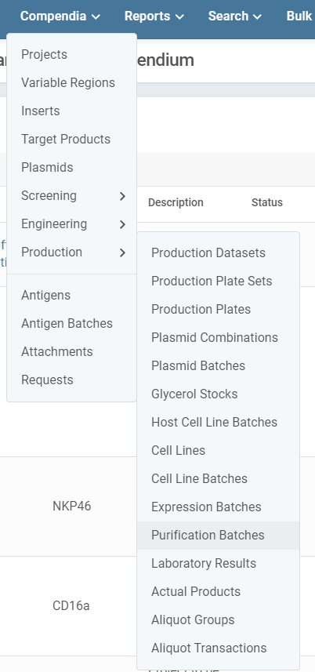
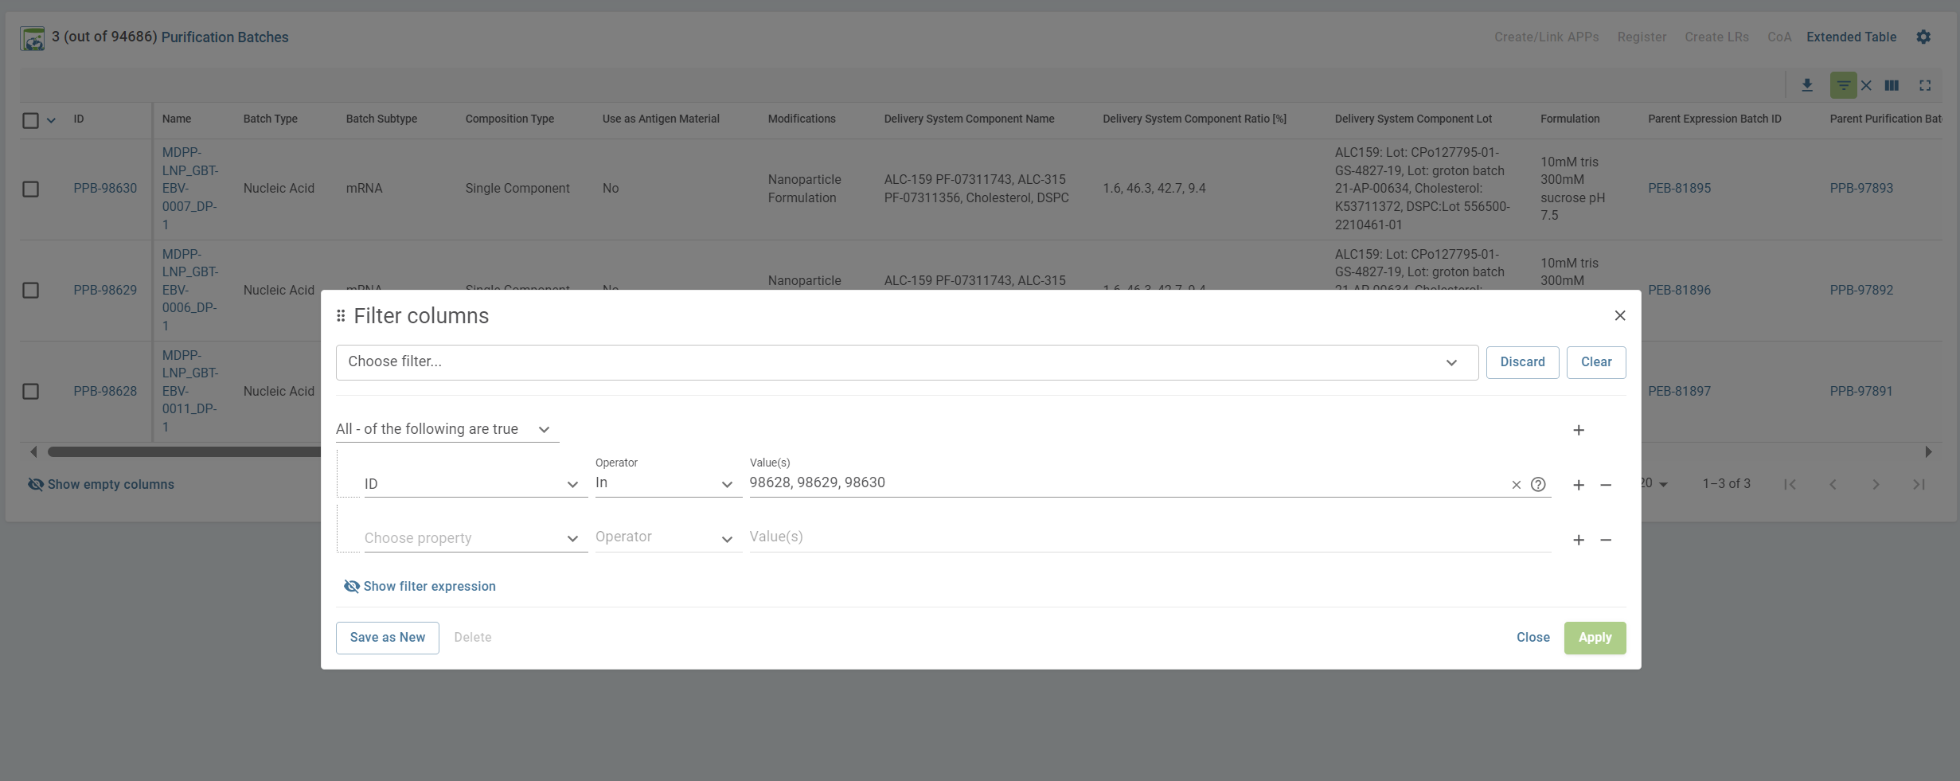
Diana Addition – can be simpler to navigate through Compendia – Production – Purifications Batches
And use filter in top right corner (three lines)
Have to all be of type nucleic acid
If coming from Genedata, parent request set cannot be tracked, so if possible better to request through GDBxT

Slide 5
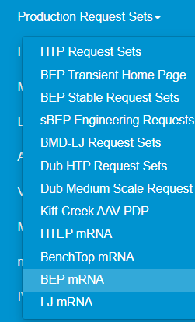
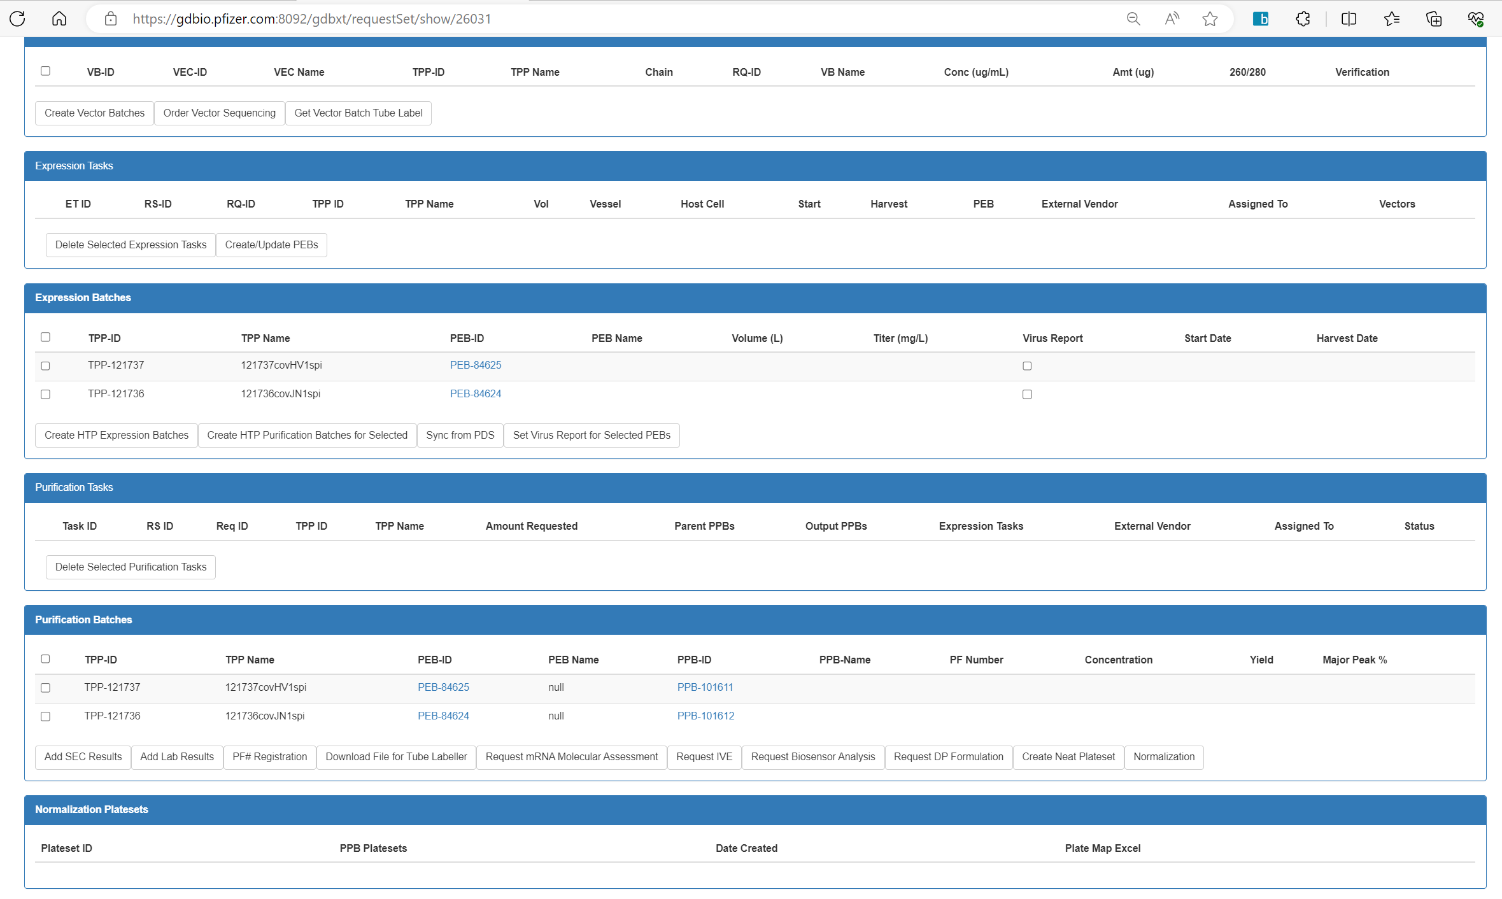
By clicking the link in BEP or HTEP mRNA Prod page
BEP IVE group is default if navigating from Genedata, BEP mRNA production, or FRS
Assay Dev group is default if navigating from HTEP mRNA production, but can always change to BEP IVE

Slide 6
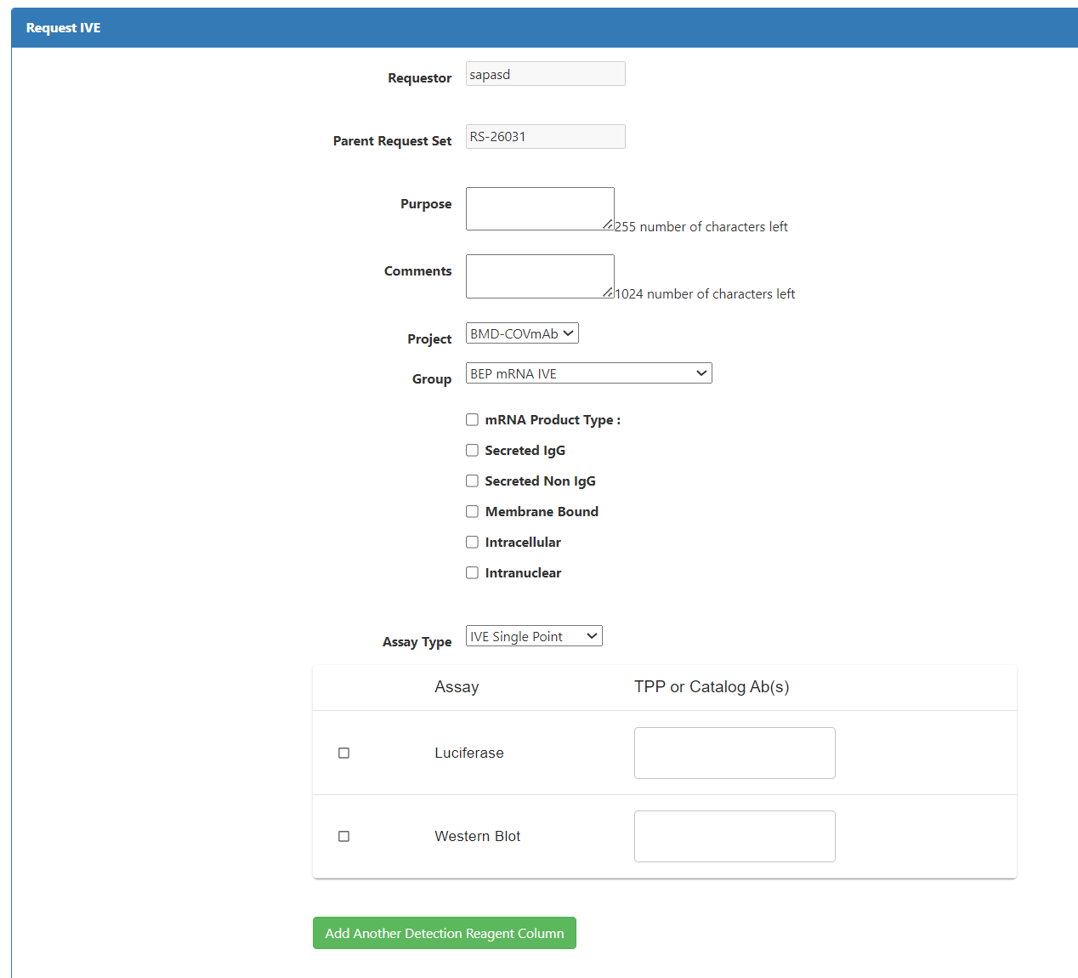
Here is where parent RS is tracked if request is coming from GDBxT production pages, if coming from Genedata this value is empty

Slide 7
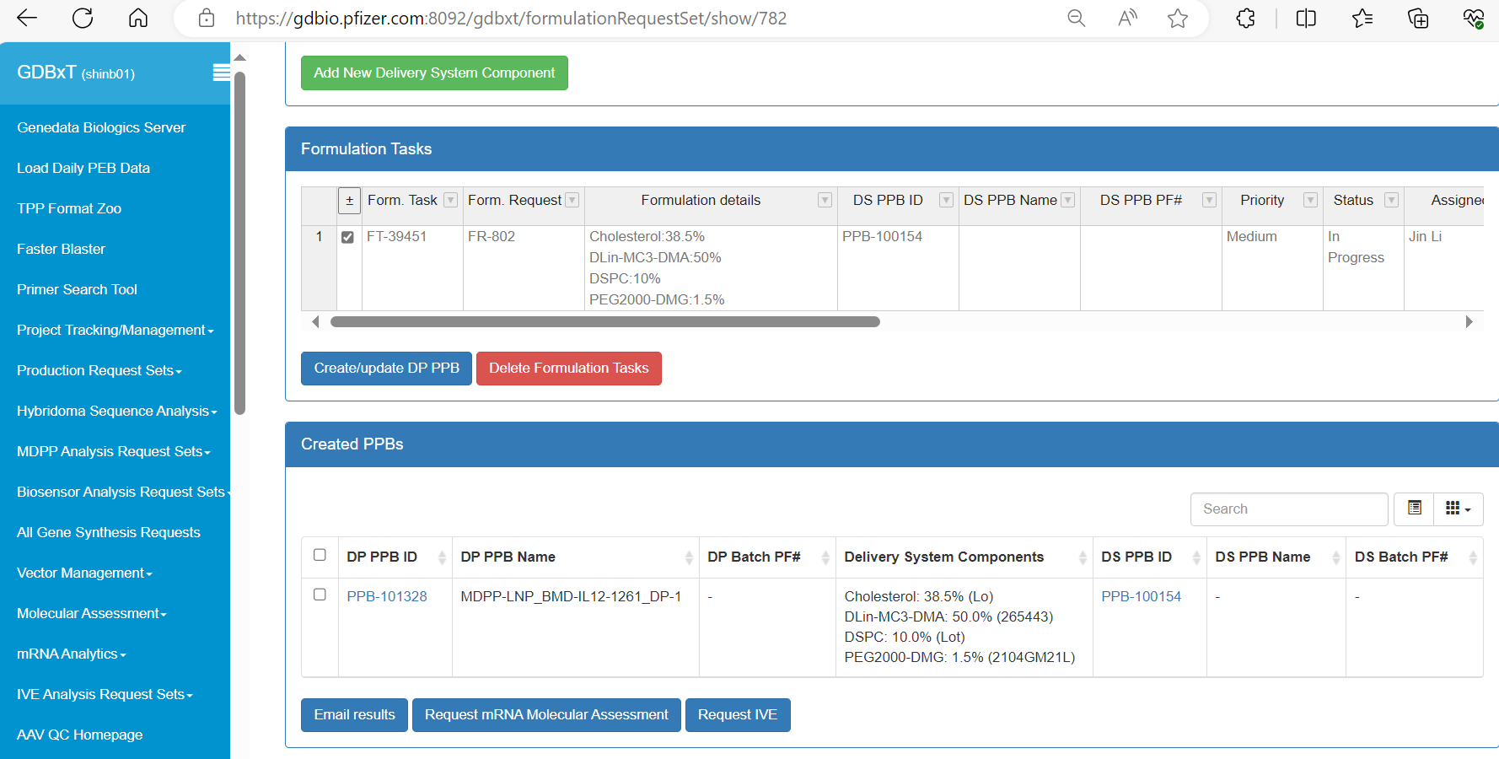
By clicking the link in FRS production page
Select samples

Slide 8
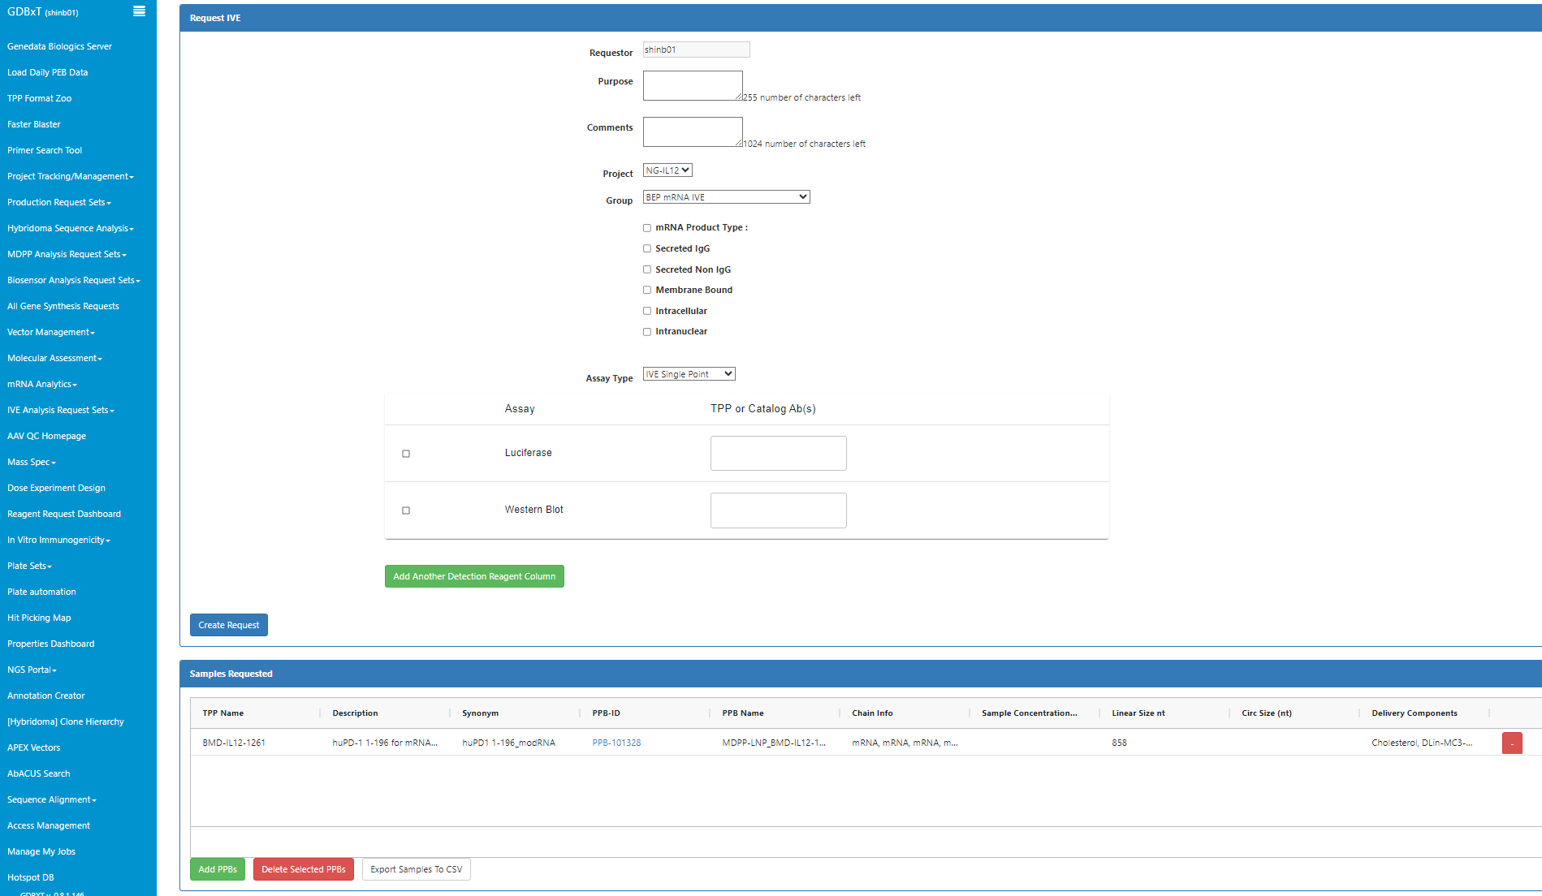
Request Page
Please select BEP mRNA IVE
Please fill out
all the section
You can choose single point or dose response
If you have multiple Abs, add detection reagent column
Click this button to create request
If you have multiple samples, add multiple PPBs

Slide 9
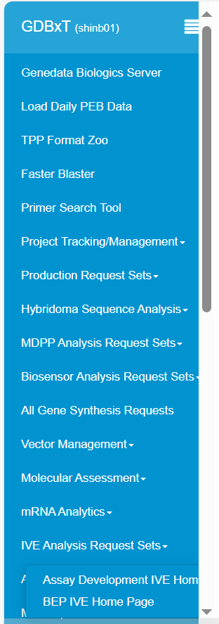
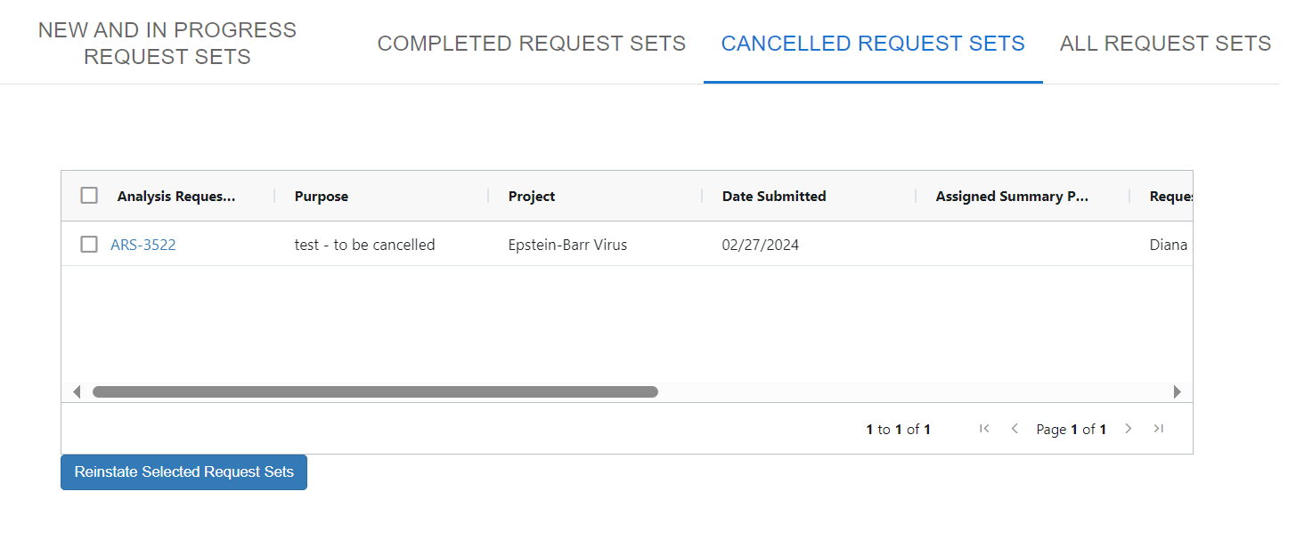
Track your request
Diana note – I would show tab with new and in progress request sets, the link to the request set show page is also part of confirmation email ( I added that to the next slide)
Just a heads up, the webpage remembers which tab you clicked last so when you load the home page it will default to the last tab you clicked – in All Request samples and assays the filters that you used will also be remembered

Slide 10
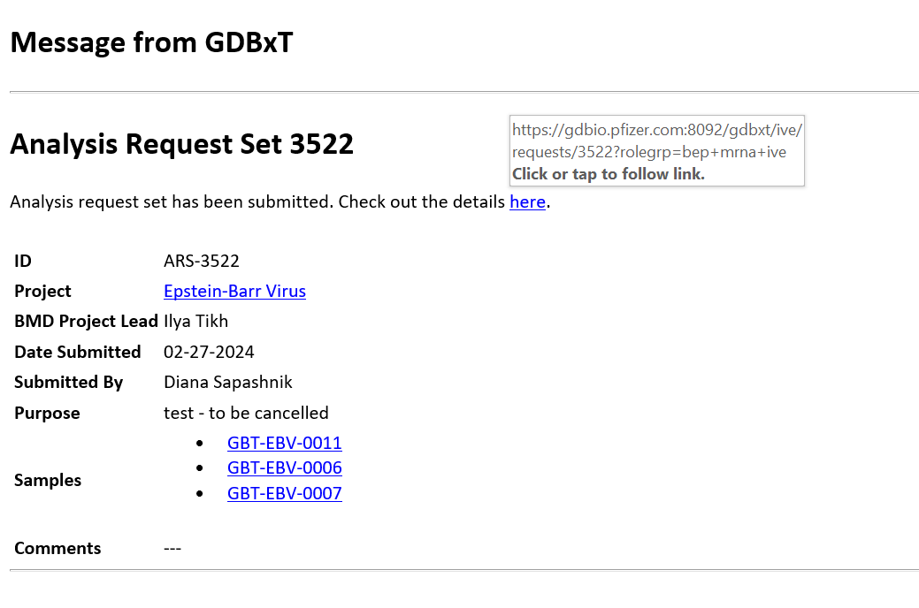
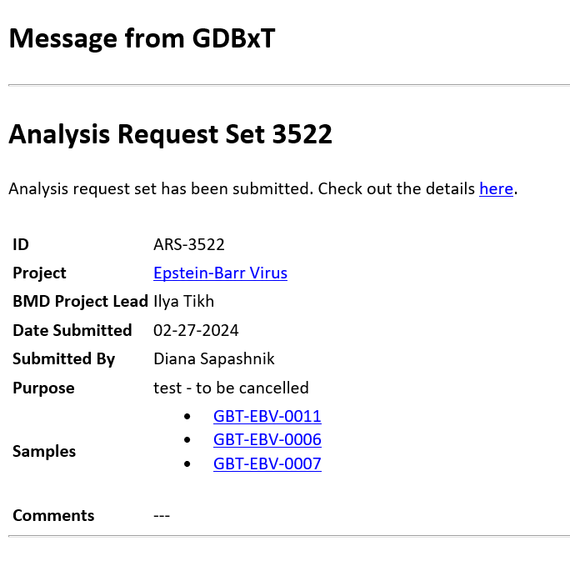
Confirmation of your request

Slide 11
Thank You

